Slide 1

A Self-Tracked Analysis of Late-Night Resistance Training and Daily Productivity: The Role of Intensity and Behavioral Factors
James Cedrick P. Villanueva
College of Computing and Information Technology
National University – Manila
60-Day Self-Tracked Study

Slide 2
INTRODUCTION
REGRESSION
overview
PROBLEM STATEMENT
INSIGHTS
OBJECTIVES
SCOPE & LIMITATION
HYPOTHESES
DATA COLLECTION
EDA
CORRELATION ANALYSIS

Slide 3
INTRODUCTION
In today’s modern digital lifestyle, individuals are frequently exposed to high screen time, flexible schedules, and late-night routines. Productivity is influenced not only by psychological factors but also by behavioral patterns such as exercise habits, sleep duration, and digital exposure. While physical activity is generally associated with improved mood, energy, and cognitive function, most existing research focuses on daytime exercise. However, many students and professionals only have time to train at night. This study examines whether late-night resistance training enhances or impairs next-day productivity using a 60-day quantified-self longitudinal dataset.
A Self-Tracked Analysis of Late-Night Resistance Training and Daily Productivity: The Role of Intensity and Behavioral Factors

Slide 4
PROBLEM STATEMENT
  Does late-night resistance training enhance or impair next-day productivity?
  How do sleep and screen time influence productivity?
A Self-Tracked Analysis of Late-Night Resistance Training and Daily Productivity: The Role of Intensity and Behavioral Factors

Slide 5
OBJECTIVES
  Collect 60-day dataset.
  Analyze relationships.
  Compare workout vs rest
  Model predictors via regression
A Self-Tracked Analysis of Late-Night Resistance Training and Daily Productivity: The Role of Intensity and Behavioral Factors

Slide 6
HYPOTHESES
  CORRELATION HYPOTHESES
Null Hypothesis
There is no significant linear relationship between perceived workout intensity, sleep duration, screen time, and next-day productivity (r = 0).
Alternative Hypothesis
At least one variable (perceived intensity, sleep duration, or screen time) has a significant linear relationship with next-day productivity (r ̸= 0).
  WORKOUT PARTICIPATION HYPOTHESES (Independent T-test)
Null Hypothesis
There is no significant difference in mean productivity between workout days and rest days
Alternative Hypothesis
There is a significant difference in mean productivity between workout days and rest days
A Self-Tracked Analysis of Late-Night Resistance Training and Daily Productivity: The Role of Intensity and Behavioral Factors

Slide 7
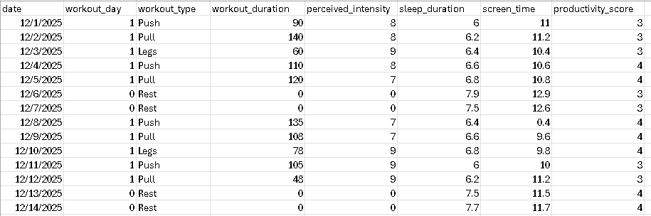
DATA COLLECTION
60 Days

Slide 8
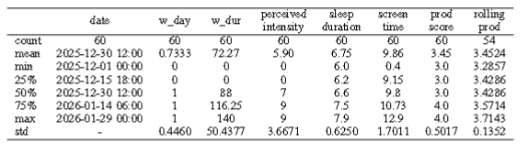
EXPLORATORY DATA ANALYSIS (EDA)

Slide 9
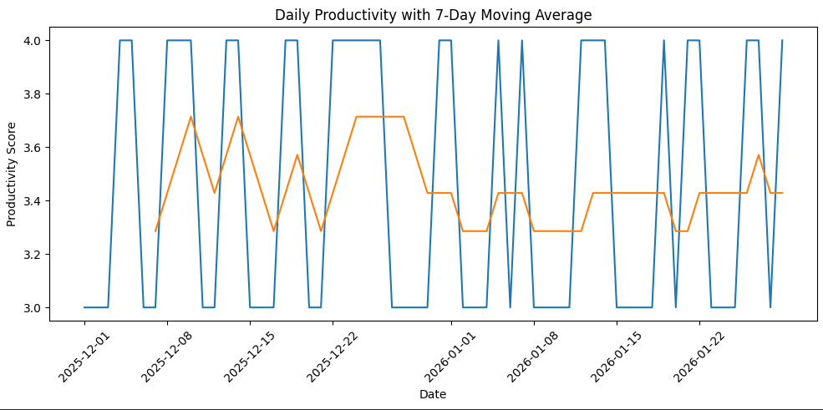
EXPLORATORY DATA ANALYSIS (EDA)
PRODUCTIVITY TREND

Slide 10
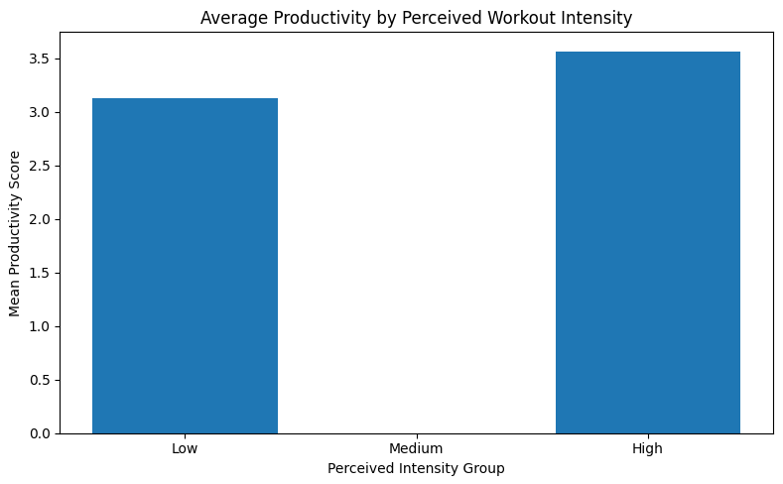
CORRELATION
AVERAGE PRODUCTIVITY BY PERCEIVED WORKOUT INTENSITY
Intensity vs Productivity: r=0.393, p=0.0019

Slide 11
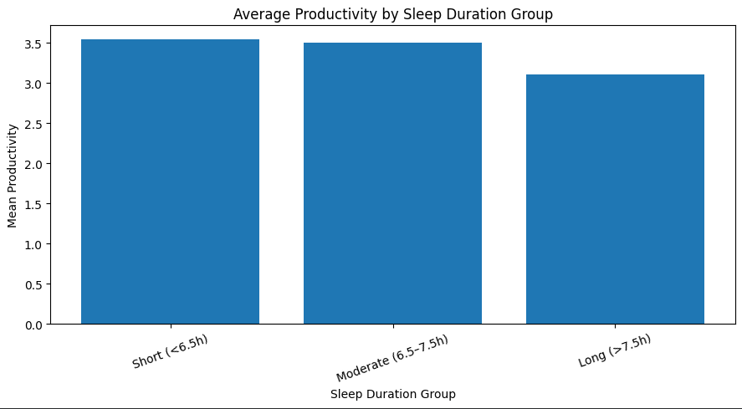
CORRELATION
AVERAGE PRODUCTIVITY BY SLEEP DURATION
Sleep vs Productivity: r=-0.305, p=0.0177

Slide 12
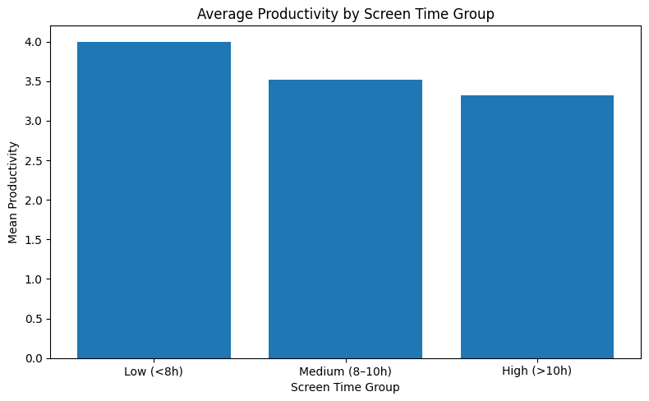
CORRELATION
AVERAGE PRODUCTIVITY BY SCREEN TIME
Screen Time vs Productivity:
r=-0.307, p=0.0169

Slide 13
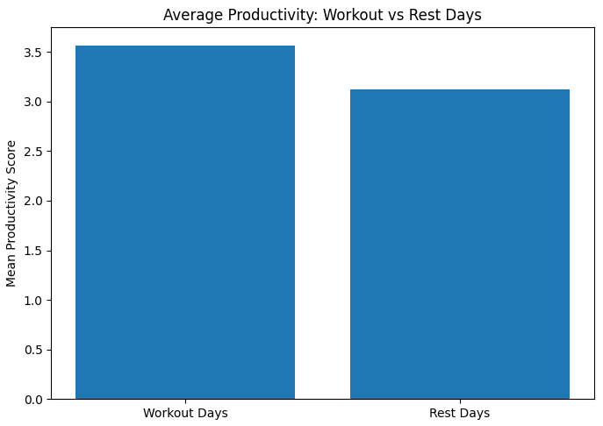

T-TEST: WORK OUT VS REST DAYS

Slide 14
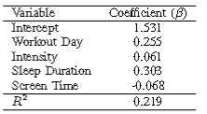
REGRESSION RESULT FOR PRODUCTIVITY
Variable | Coefficient
Intercept | 1.531
Workout Day | 0.255
Intensity | 0.061
Sleep Duration | 0.303
Screen Time | -0.069

Slide 15
INSIGHTS
  Late-night training does not impair productivity.
  Intensity strongest postive contributor
  Behavorial analytics provides actionalbe insights

Slide 16
THANK YOU!

